Slide 1
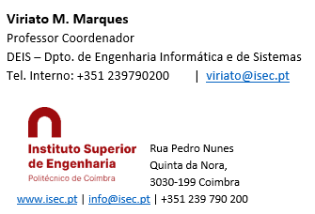
Sistemas de Informação II (LEI) Information Systems (ECS)
Lab Classes
1 - Software Installation

Slide 2
For the Lab Classes you’ll need the following software
Visual Studio (VS)
SQL Server (complete, with Business Intelligence tools) (SS)
PowerBI Desktop
Excel
The PCs of the lab classes are ready to use:
For SQL Server the login is “sa” and the password is “1234”
However, you need to install all this software on your own PC’s in order to grant to follow up your own work and not the one of other colleagues along the classes, as they are all sequential. Moreover, the software is needed for the evaluation practical work!
Install by following the order above (VS -> SS -> PowerBI) and according to the instructions on the following slides:

Slide 3
SQL Server and Visual Studio recommended Versions
Visual Studio 2019, 2017 or 2012
SQL Server 2019, 2017 or 2012 Developer Edition (this version is free)
SQL Server 2019 or 2017 Data Tools (for 2012 versions, not needed)
Other versions such as 2016 or 2013 are also possible. However, in order to avoid possible problems, the SQL Server and the Visual Studio versions (year) should be the same
In case of SQL Server 2019, and once the applications above described have been successfully installed, you’ll need to install SQL Server 2019 Management Studio (SSMS) too
Versions 2012 should be used only if you couldn’t succeed installing 2017 or 2019. In this case I will give you a link where SQL Server and Visual Studio 2012 will be available.

Slide 4
The links for the downloads are:
Download of Visual Studio
https://visualstudio.microsoft.com/vs/older-downloads/
Download of SQL Server (SS) Developper Edition
https://www.microsoft.com/en-us/sql-server/developer-tools
Download of SQL Server Datatools
For 2017: https://docs.microsoft.com/en-us/sql/ssdt/download-sql-server-data-tools-ssdt?view=sql-server-ver15
For 2019 (see Slide 10): https://docs.microsoft.com/en-us/sql/ssdt/download-sql-server-data-tools-ssdt?view=sql-server-ver15#ssdt-for-visual-studio-2019
Download of SQLServer 2019 Management Studio (needed for SS 2019 version only!)
https://docs.microsoft.com/en-us/sql/ssms/download-sql-server-management-studio-ssms?view=sql-server-ver15#download-ssms
Download of PowerBI Desktop
https://powerbi.microsoft.com/en-us/downloads/ (choose the Desktop Version it is the only free one)

Slide 5
SQL Server Installation (1)
Before installing SQL Server, if there is any version of SQL Server or SQL Server Express on your PC, begin by uninstalling it, completely and carefully, using the Windows Control Panel;
During install you’ll see that SQL Server Setup begins by testing the PC, Windows and some of the installed software. If there is any red error (fatal error) don’t go on: it must be corrected first! However, it is normal a yellow error (warning) about the Windows firewall. This warining doesn’t matter. You may proceed;
The install is a little bit long and heavy process. Carefully read and follow the following instructions.

Slide 6
SQL Server Installation (2)
To choose what to install: “Select All”
For 2017 and 2019 versions there are 3 installation modes: Tabular, Multidimensional and Data Mining, and Power Pivot. It is mandatory to choose the Multidimensional and Data Mining mode. Any other mode won’t be good for our classes and you’ll have to uninstall and restart all over again!!
In the Authentication Mode change it for Mixed Autenthication. This way the installation process will create an administrator allways called “sa” and will aks you for a password: you must create it at your own wish, and keep it. Do not forget this pwd: it will be frequently needed in the classes!
The install will also display, for several times, “Add User Account”. Choose “Add current user”
All the other default values, showed by the system, may be accepted
Some detailed installation hints in the next slides

Slide 7
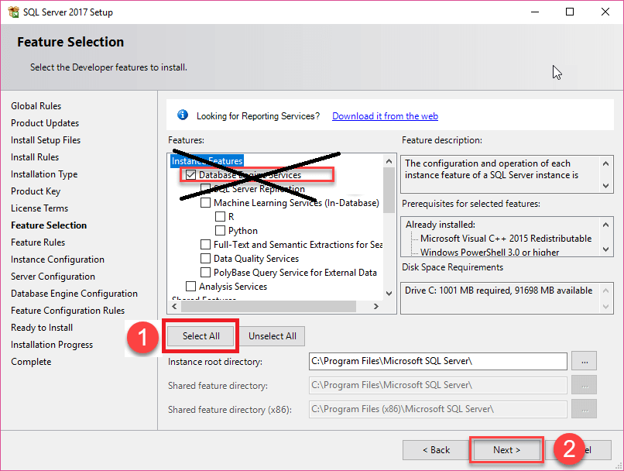
SQL Server 2017 Detailed Instalattion hints (use if needed)
https://www.sqlservertutorial.net/install-sql-server/
This tutorial may be helpfull. However:
Instead of choosing Database Engine Services, you must choose Select All
Some steps after, choose Multidimensional and Data Mining mode
This tutorial finishes by intalling SQL Server Management Studio. This should not be needed for this 2017 version

Slide 8
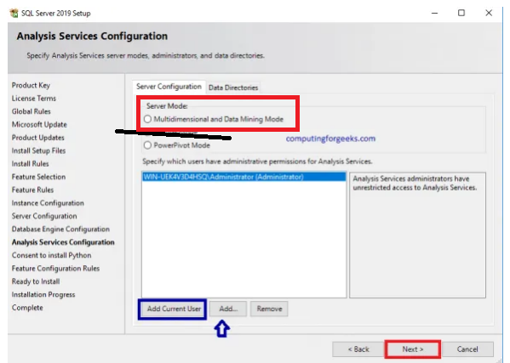
SQL Server 2019 Detailed Instalattion hints (use if needed)
https://computingforgeeks.com/install-sql-server-developer-edition-on-windows-server/
This tutorial may be helpfull. However:
Instead of choosing Tabular Mode you must choose MultiDimensional and Data Mining Mode
After finishing, proceed to points 7. 8. in pg. 4 and install SSMS (SS Management Studio)

Slide 9
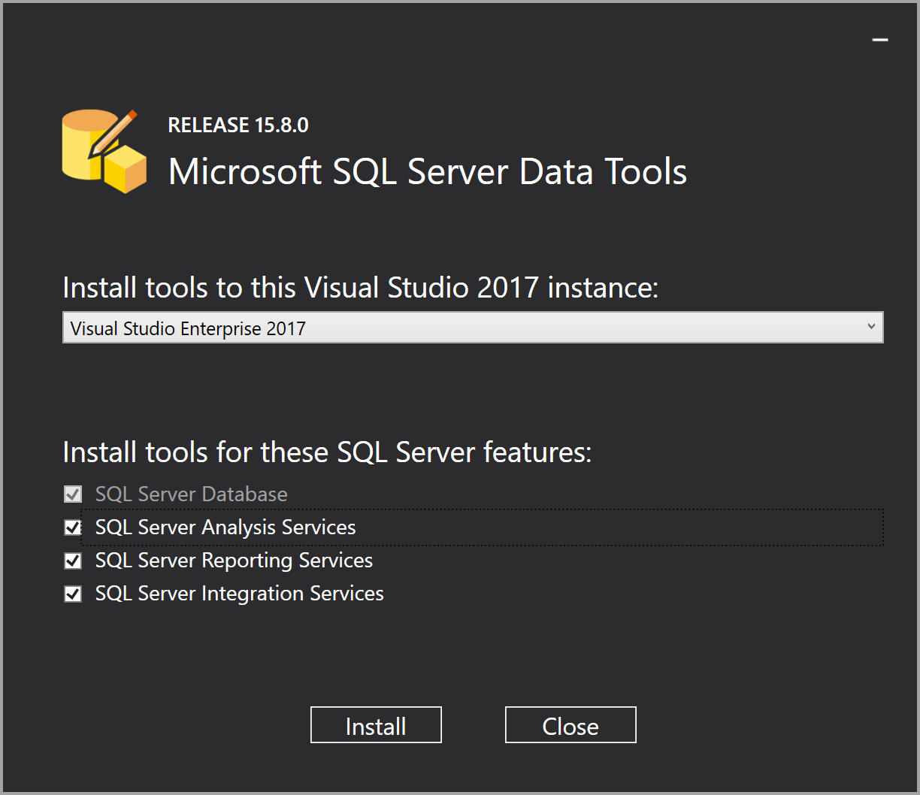
SQL Server Data Tools (SSDT) Installation 2017
Needed for SQL Server 2017
Download the correct version of Datatools following the link provided in the previous slides
Install as shown, by selecting:
Analysis Services
Reporting Services
Integration Services

Slide 10
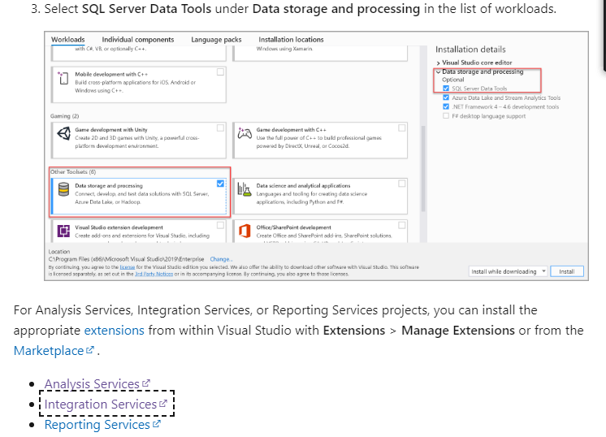
SQL Server Data Tools (SSDT) Installation 2019
Needed for SQL Server 2019
The tools must be downloaded separatelly
https://docs.microsoft.com/en-us/sql/ssdt/download-sql-server-data-tools-ssdt?view=sql-server-ver15#ssdt-for-visual-studio-2019
In the page of this link look for the figure on left. Install, one by one, following each link, the extensions
Analysis Services
Reporting Services
Integration Services

Slide 11
SQL Server Management Studio (SSMS) Installation
This installation is needed for SQL Server 2019 only!
This is a very straightforward process. Just download SSMS following the provided link in the previous slides, and install it.
Power BI Desktop Installation
Just download PowerBI following the provided link in the previous slides, and install it. Be sure to choose Desktop version, the only free version provided!
Excel Installation
Excel is not available for free and opensource similar versions won’t work for our purposes. So, if you have it on your PC, fine! If not … that won’t be very important… try to solve it if possible …

Slide 12
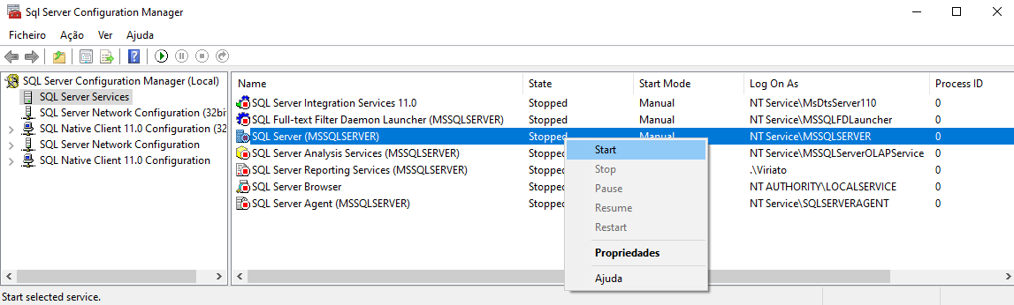
Verifying the Installations (1)
Start the SQL Server Configuration Management. It should look like this:
Right click the SQL Server service (database) and “Start”
Right click also the Analysis Services, Integration Services, Agent, and “Start”
Try to Start the SQL Server browser. If it is not active, open the Windows Services (Control Panel), look for it, change the mode to Manual. Return here and Start it.

Slide 13
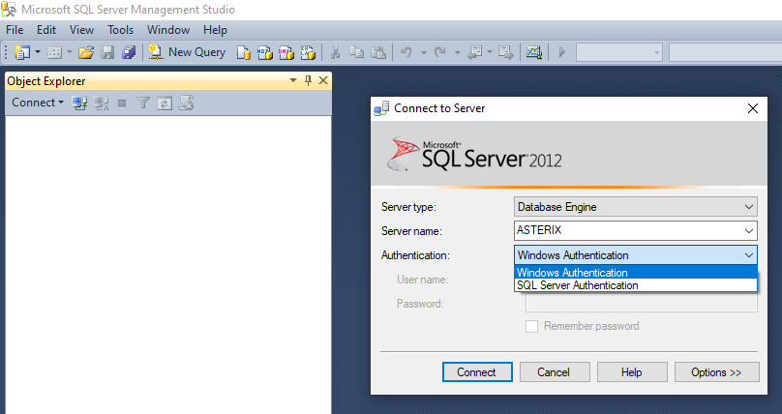
Verifying the Installations (2)
Start the SQL Server Management Studio. It should look like this:
Try to Login using Windows Authentication. It should work!
Close the Management Studio, start it again, and try to login as SQL Server Authentication, User name “sa” and using the password you created when intalling the SQL Server. It should work!

Slide 14
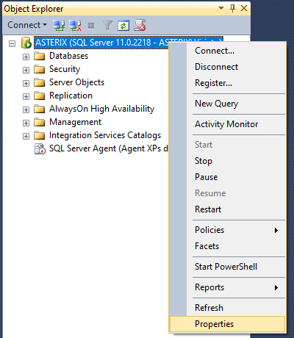
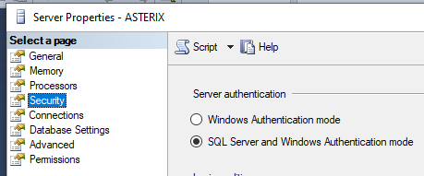
Verifying the Installations (3)
If the login using SQL Server Authentication failed: start by loging in using the Windows authentication. Then:
Right click the server name and Properties
Select Security and change it to SQL Server and Windows authentication

Slide 15
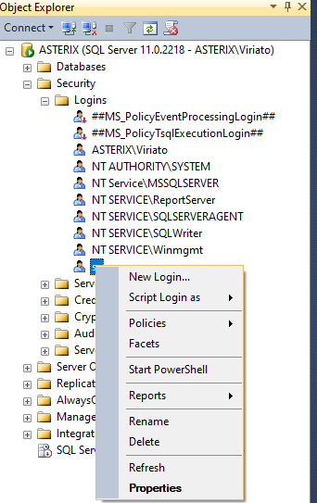
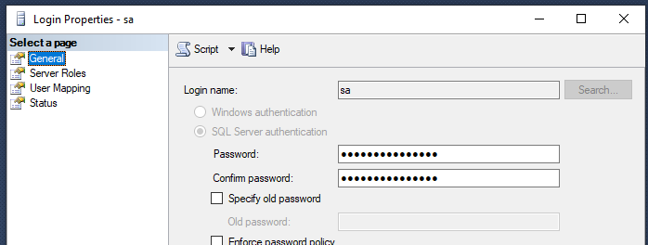
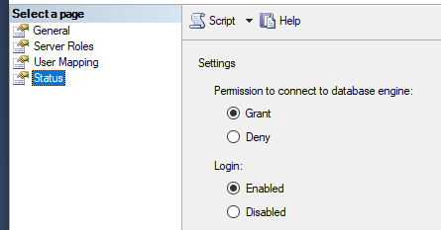
Verifying the Installations (4)
Close the form and then select Logins, sa, Properties
In General, uncheck the “Enforce Password Policy” . WARNING: do not touch the Password and Confirm Password Fields, unless you want explicitly to change the password!!
In Status configure
as shown
3. Save, close the Management
Studio and try again to login as
“sa” and your password

Slide 16
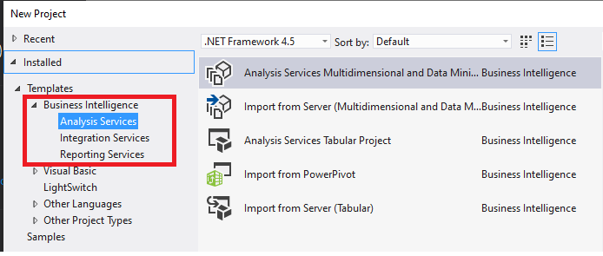
Verifying the Installations (5)
Start the Visual Studio running it as Administrator, and choose File -> New -> Project
You’ll have to find something similar to the figur above, i.e. there must be some options to create Business Intelligence projects: Analysis, Integration and Reporting Projects
If this doesn’t show, the problem is with the installation of Datatools, or its version (year), or the SQL Server has not been installed in the Multidimensional and DataMining mode. See what happened, uninstall and reinstall as neeed until it works …

Slide 17
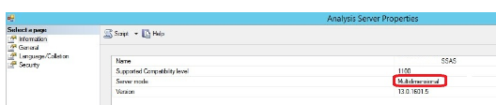
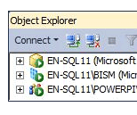
Verifying the Installations (6)
To verify the mode of SQL Server Installation, in the Management Studio right click the server name, Properties, and you’ll see its mode on a form moreless like this:
You can also look at the icon near the server name: Multidimensional and DataMining (a cube, first line of the figure) , or table (tabular mode) or powerpivot (third line)
You can try to change its mode without uninstalling and installing, by editing the msmdsrv.ini of SQL Server, that should be located in some folder similar to C:\Program Files\Microsoft SQL Server\MSAS13.TABULAR\OLAP\Config
Stop de engine. Then change the Deployment mode property from 2 (tabular) or any other value, to 0 (multidimensional). At your own risk … ☺ this is not a Microsoft recomendation … Restart the engine.
Some details here (and other sites) https://www.sqlservercentral.com/articles/how-to-change-an-analysis-services-instance-to-tabular-mode

Slide 18
Software Installation
END

